Slide 1
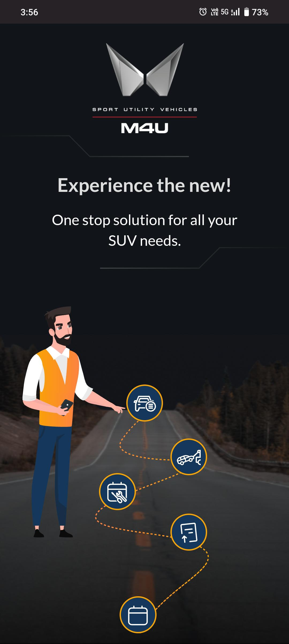
M4U Application

Slide 2
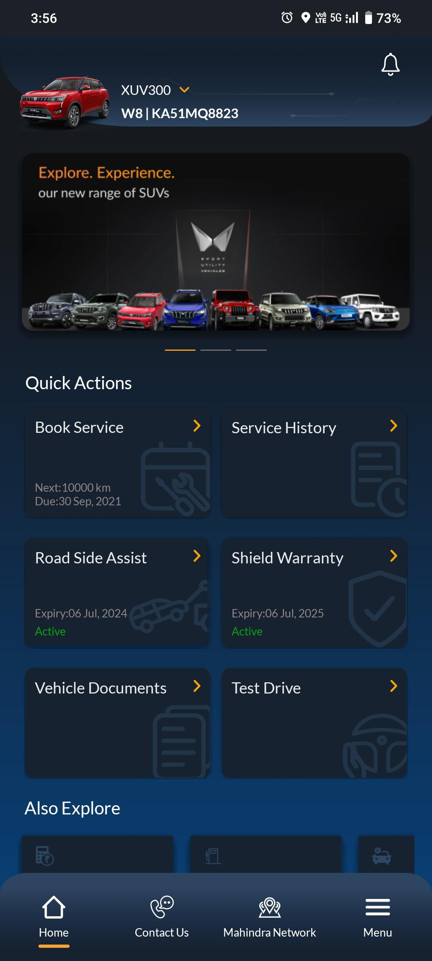
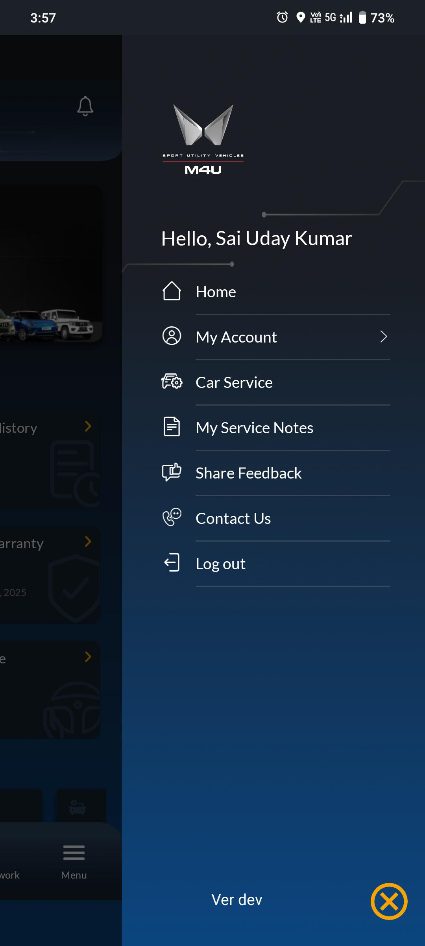
M4U App – Home Screen
To access Home Screen
Customer needs to click on Three Parelle Lines.
Home
My Account
Car Service
My Service Notes
Share Feedback
Contact Us
Logout

Slide 3
M4U App – Quick Actions
Quick Actions
Customer can be able to see multiple Options like
Book Service
Service History
Road Side Assist
Shield Warranty
Vehicle Documents
Test Drive
Cost Calculator
Fuel Log
Owner Manual

Slide 4
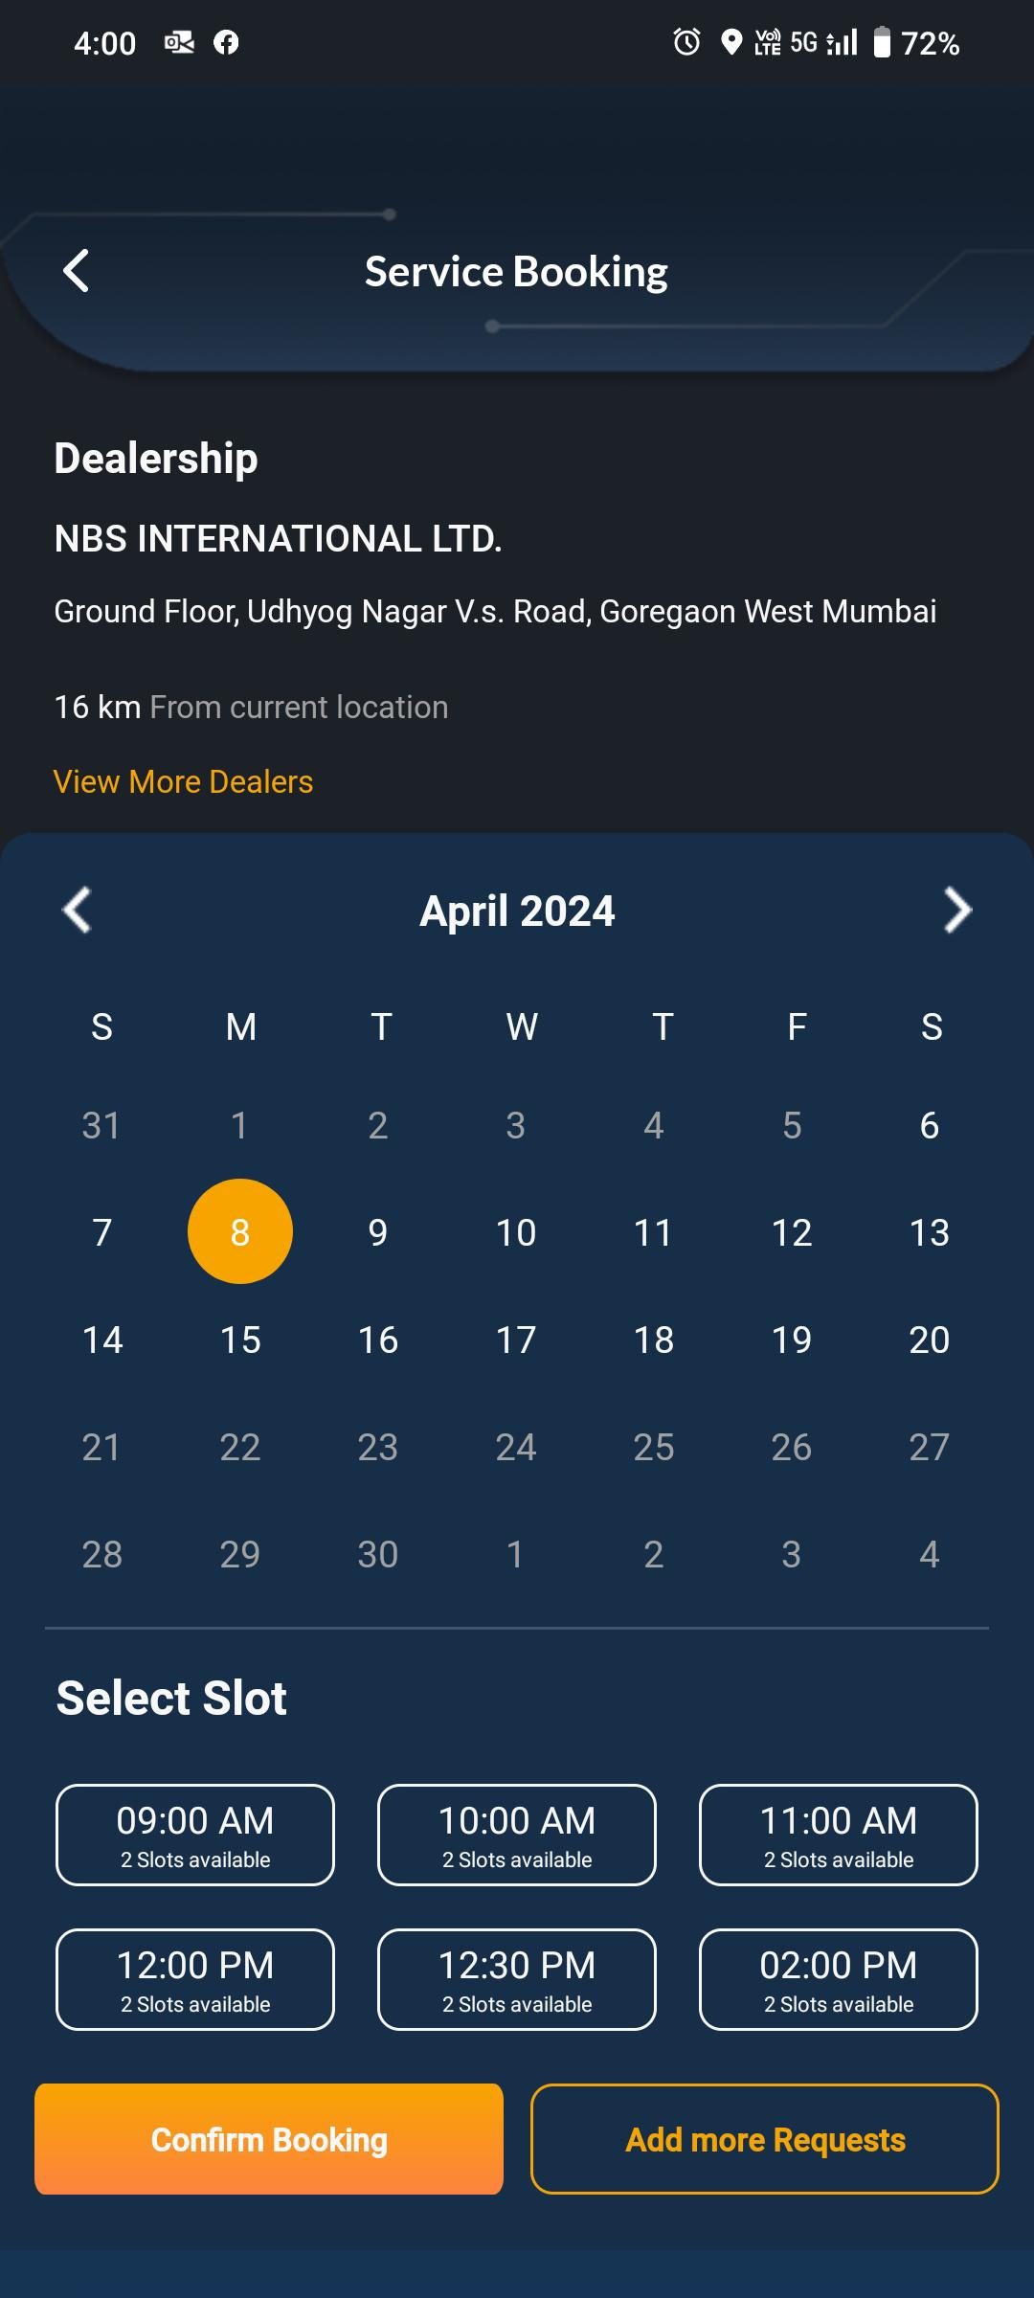
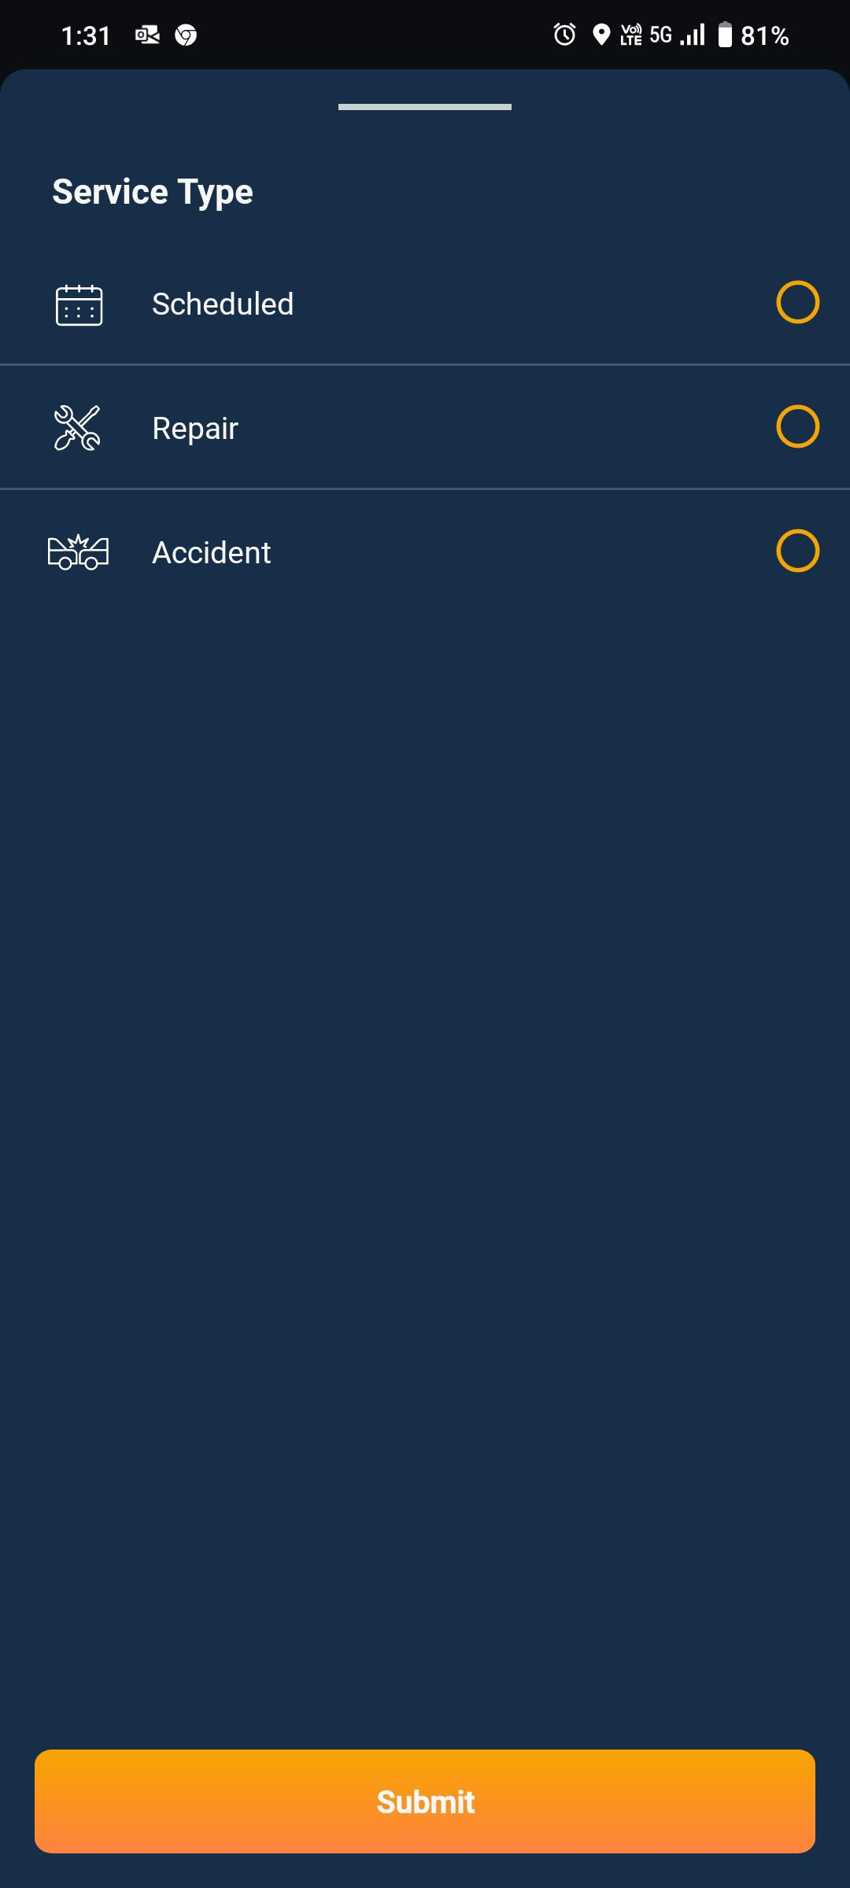
M4U App – Service Booking
Need to Select the Nature of Work
Schedule
Repair
Accidental
Service Booking
Select Dealership where he wish to do the service
For more dealership needs to click on “View More Dealers”
Select the Date when he wish to book the service appointment.
Select the preferred time slot
Then click on the Confirm Booking to

Slide 5
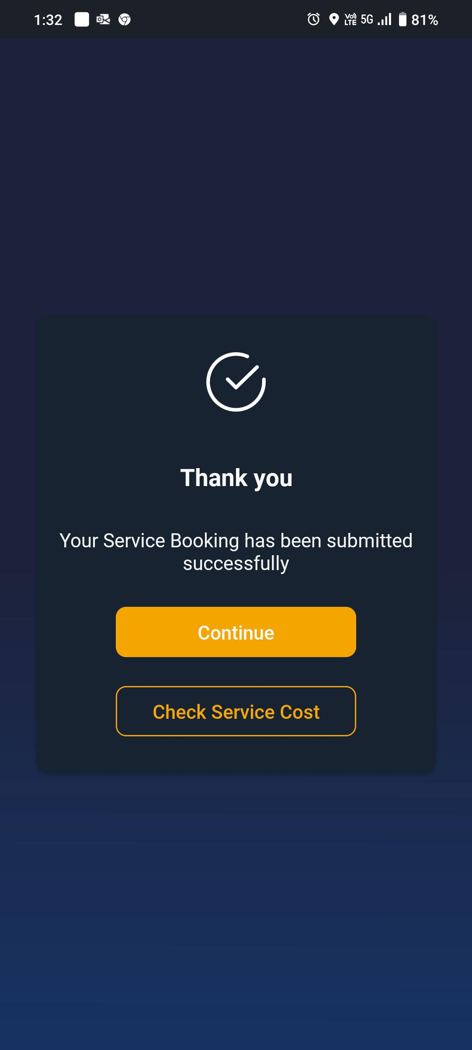
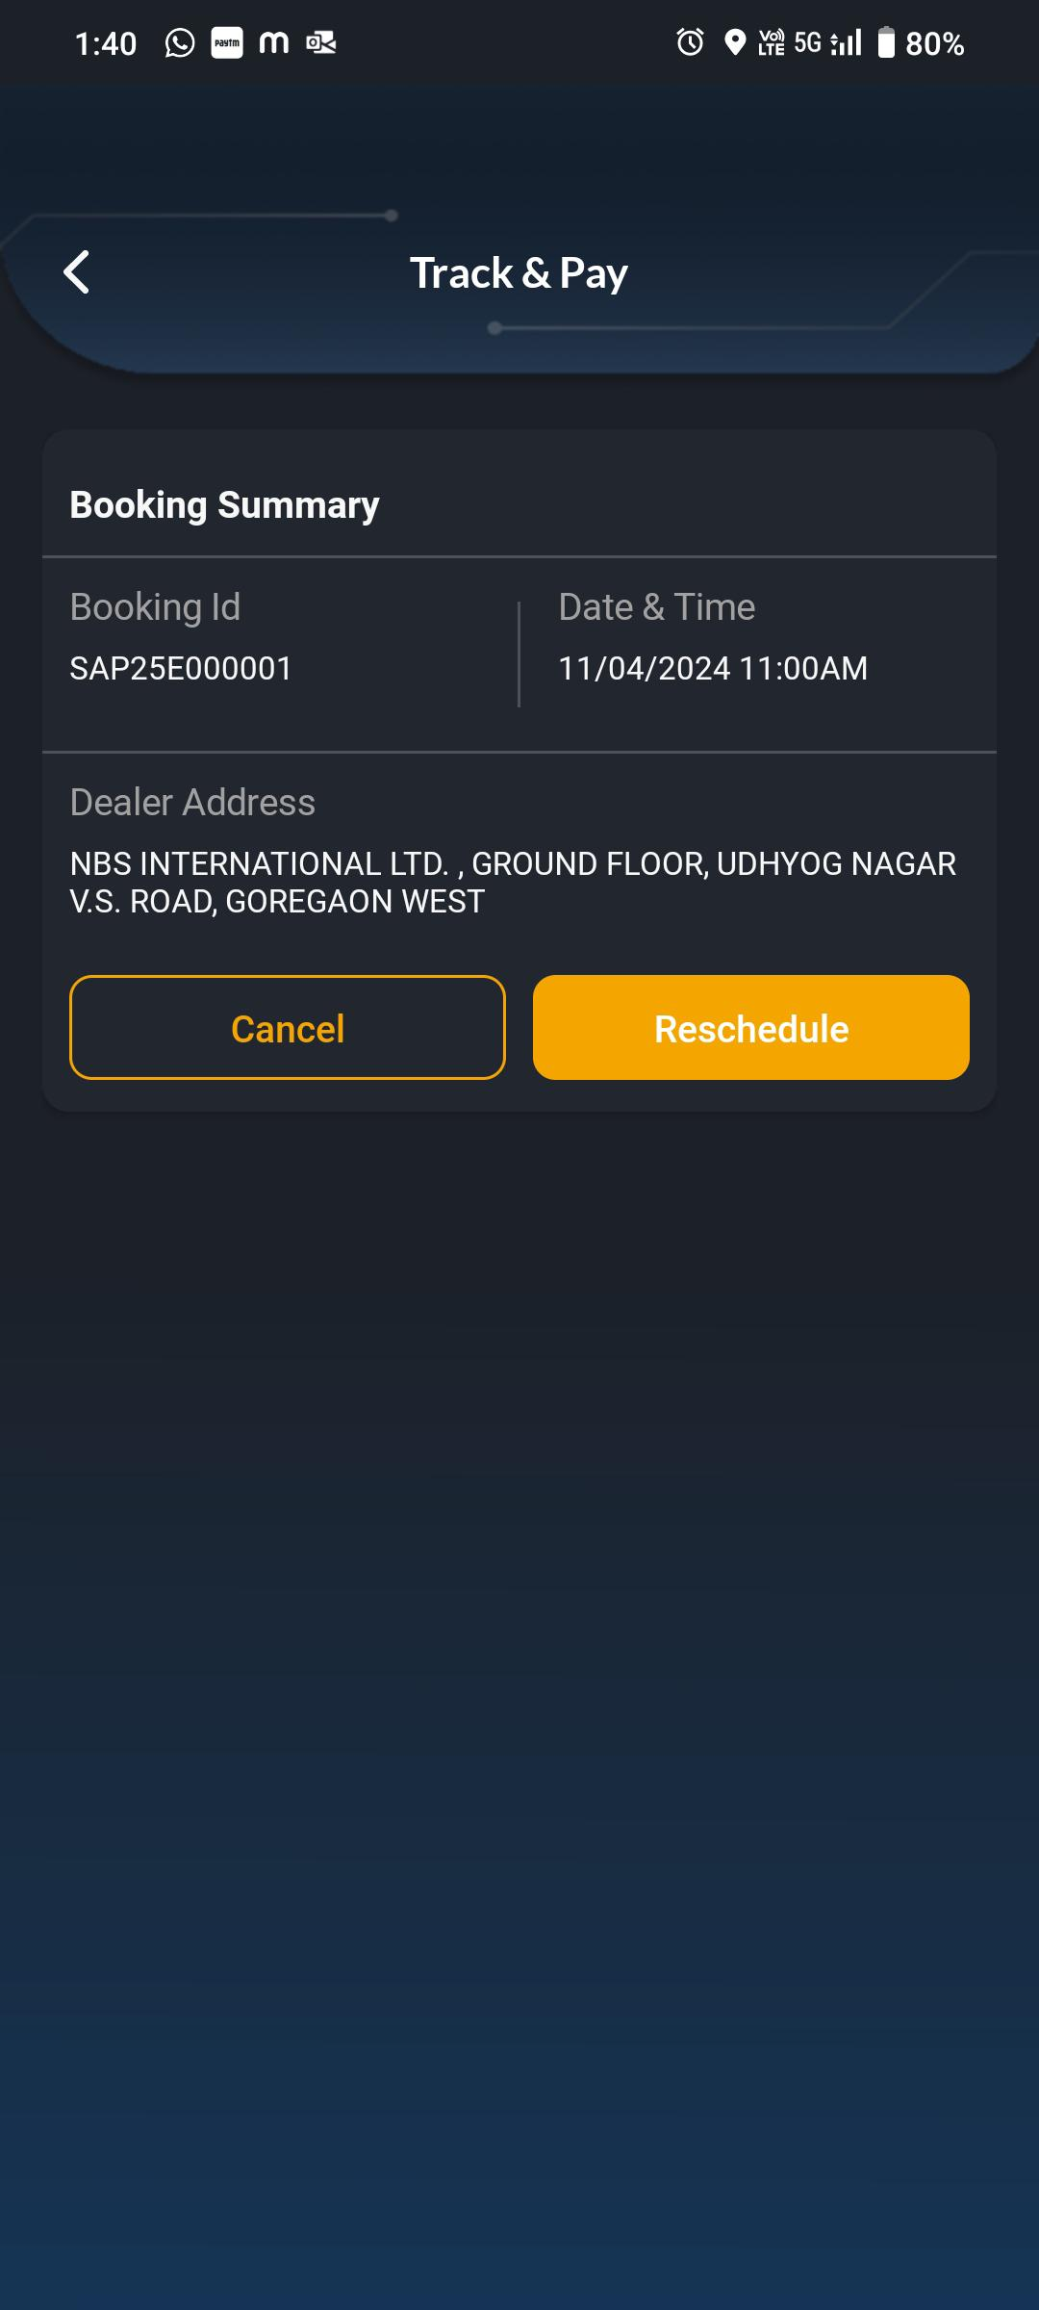
M4U App – Service Booking
Confirmation:
Customer will get the confirmation related to Service Appointment
Customer can be able to check service cost of Service as well.
Track & Pay:
If Customer wants to reschedule then he can click on the reschedule option and select the preferred date & time slot once again,

Slide 6
For Bolero Neo plus calls please refer below FAQS Link. M:\Users\6006\WYH Updates and FAQ's \Bolero Neo Plus FAQ. Please Mention Bolero Neo Plus in Subject Column. Bolero Neo+ Vehicle is available in Showrooms and we need to Fitch for Test Drive 0

